Slide 1
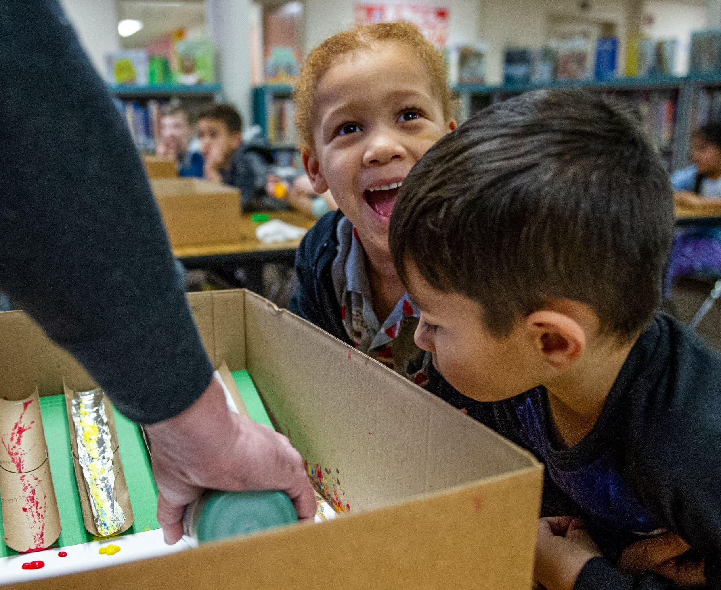
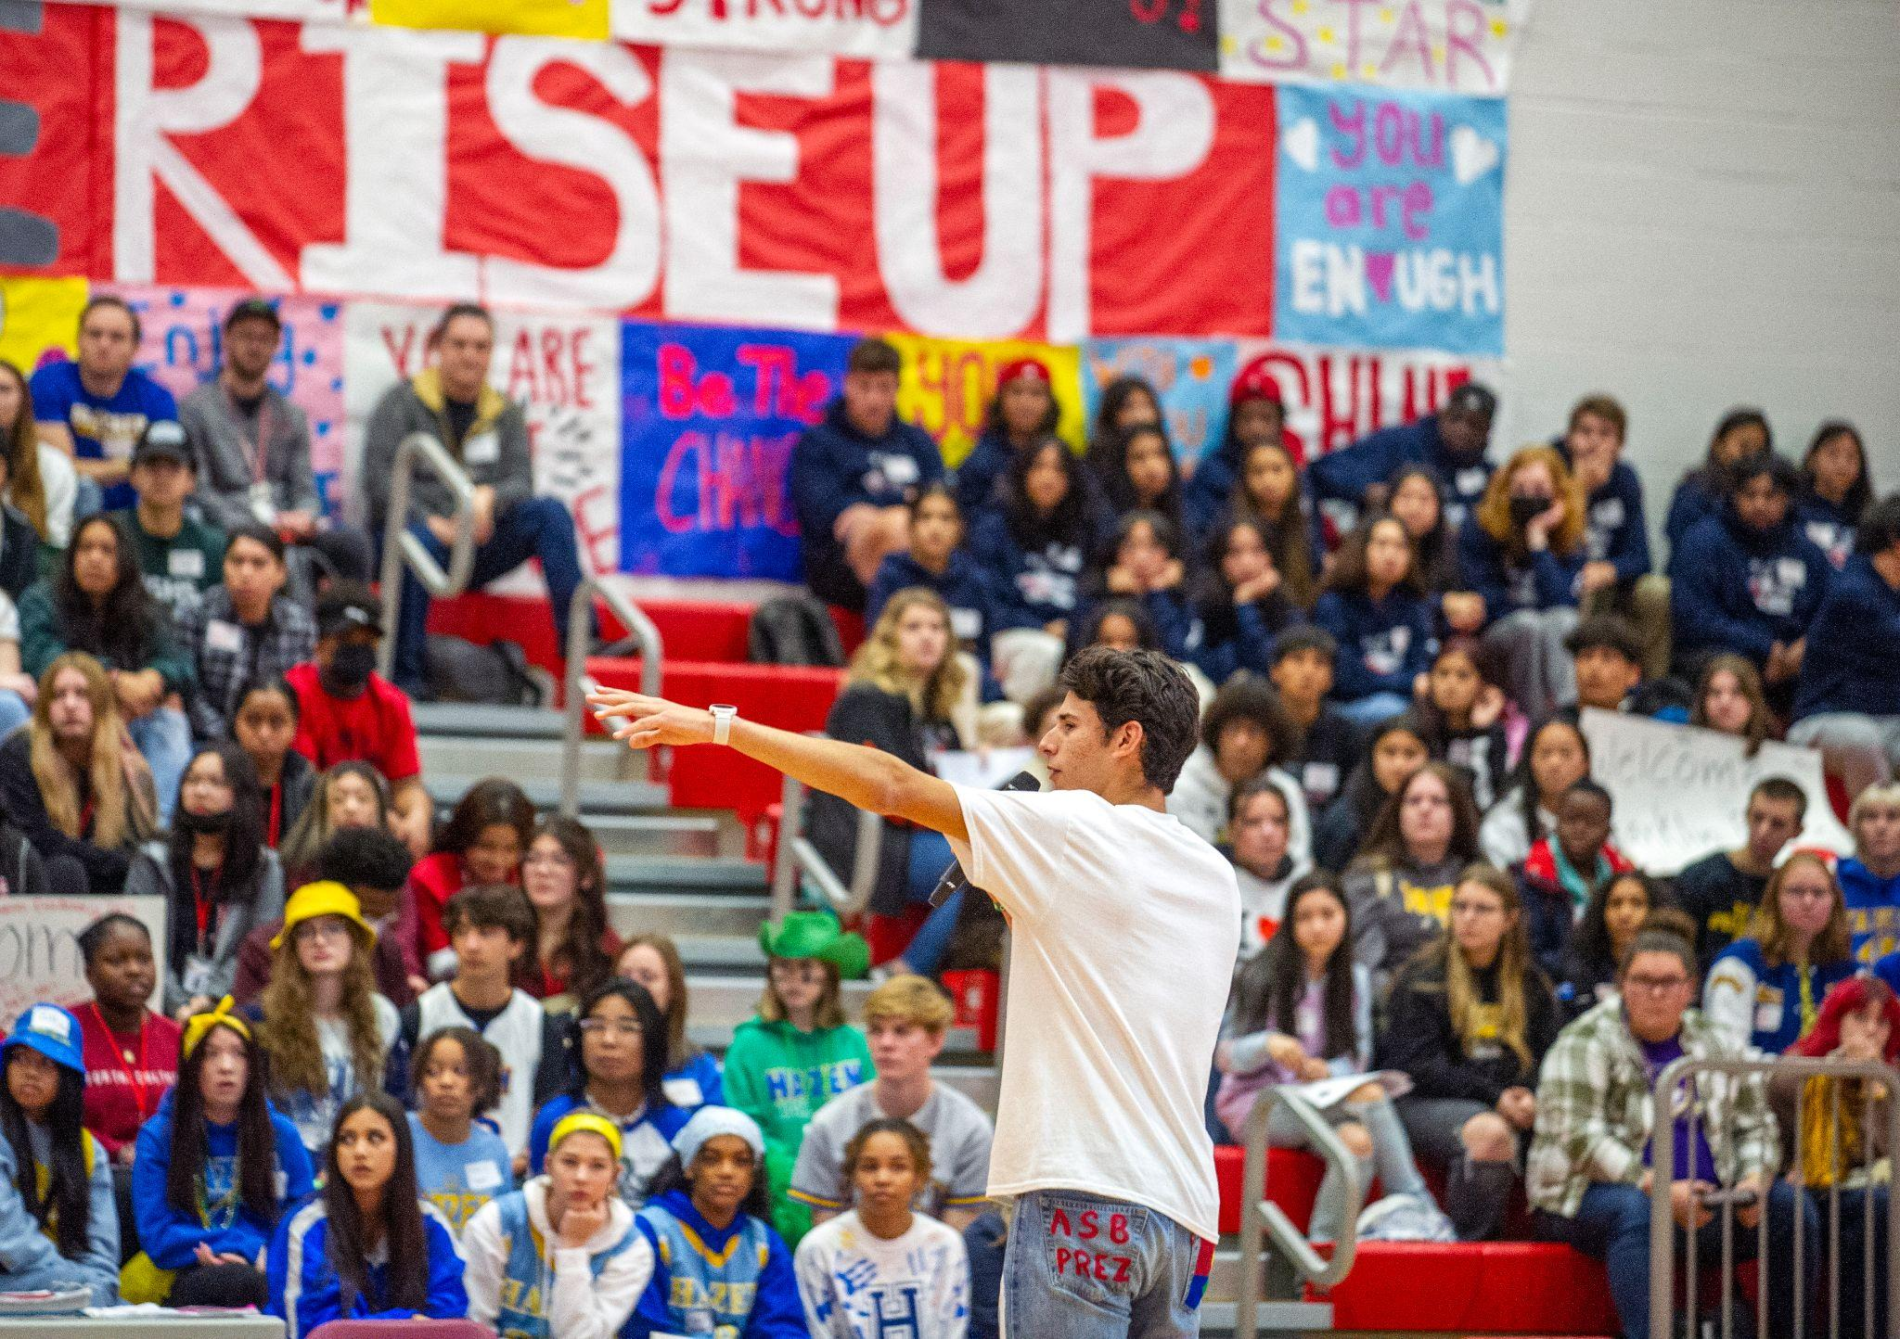
Student-Superintendent Leadership Team
OUR PROMISE
Every student in the Stanwood-Camano School District is empowered to learn in an inclusive setting and is prepared for the future of their choice.

Slide 2
Portrait of a Graduate
College, Career, Life-Ready Graduate
Effective, Collaborative Communicator
Intellectual Innovator
Resilient Scholar
Responsible, Community-minded Citizen
Solution-Seeker

Slide 3
Why SSLT? And how was it developed?
Result of challenges from earlier this fall, and a desire to place student voice and leadership at the forefront of addressing issues of race, identity and inclusion
Open application for students grades 9-12 was made available in January 2023; 30 students applied
We have about 20 students participating on the SSLT split between LHHS and SHS
Sample Agenda

Slide 4
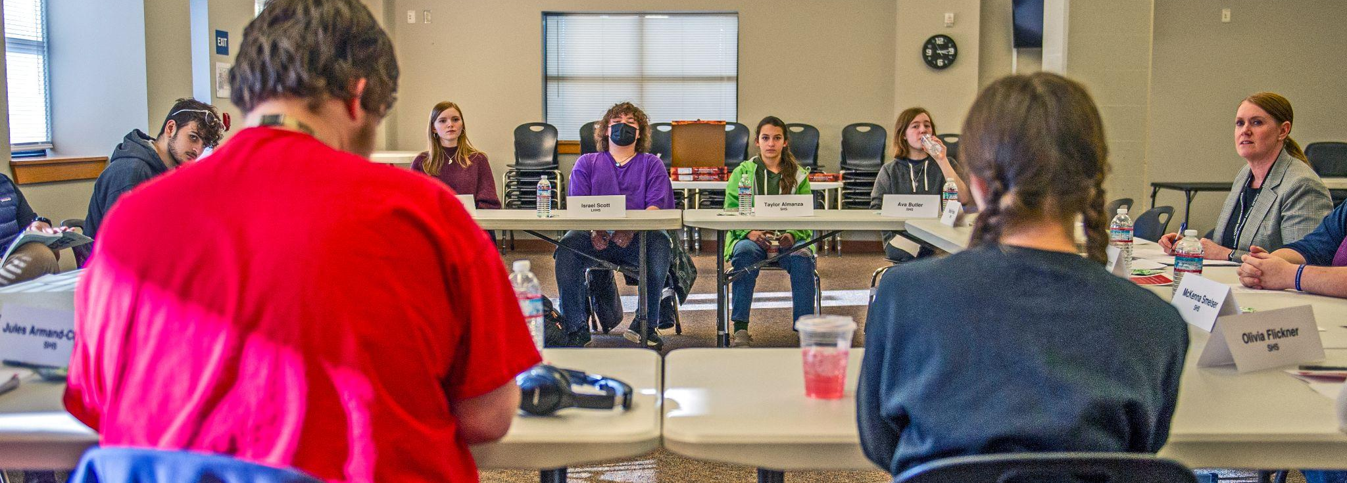
Our Charge
“The SSLT will serve as an advisory council to the Superintendent and the district as a whole on issues important to the students at LHHS and SHS.”

Slide 5
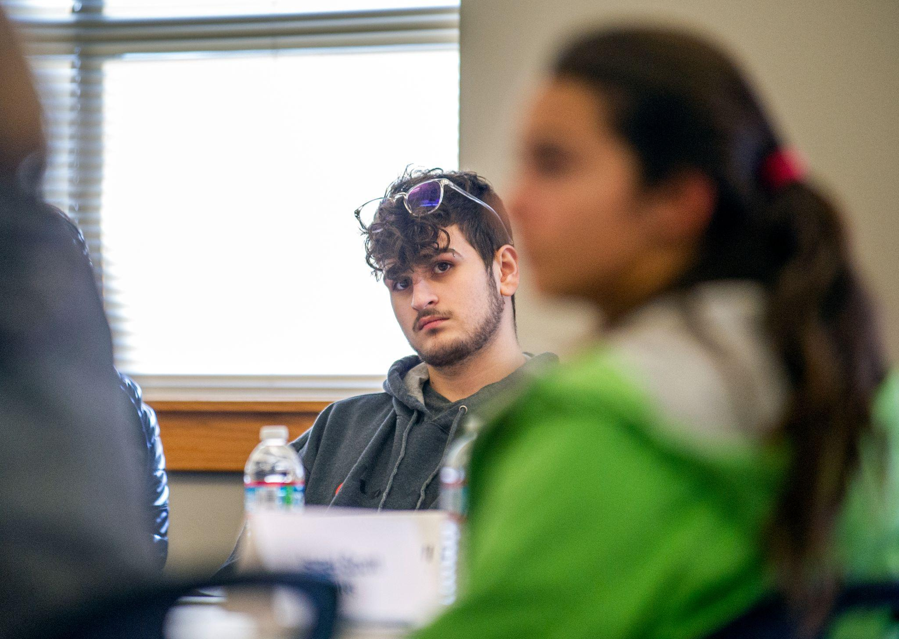
Our Meeting Schedule
2023 Meeting Dates
February 23
March 16
April 20
May 18
June 1
Meeting Time
2:45 to 4:15 p.m.
Meeting Locations
Board Room and SHS

Slide 6
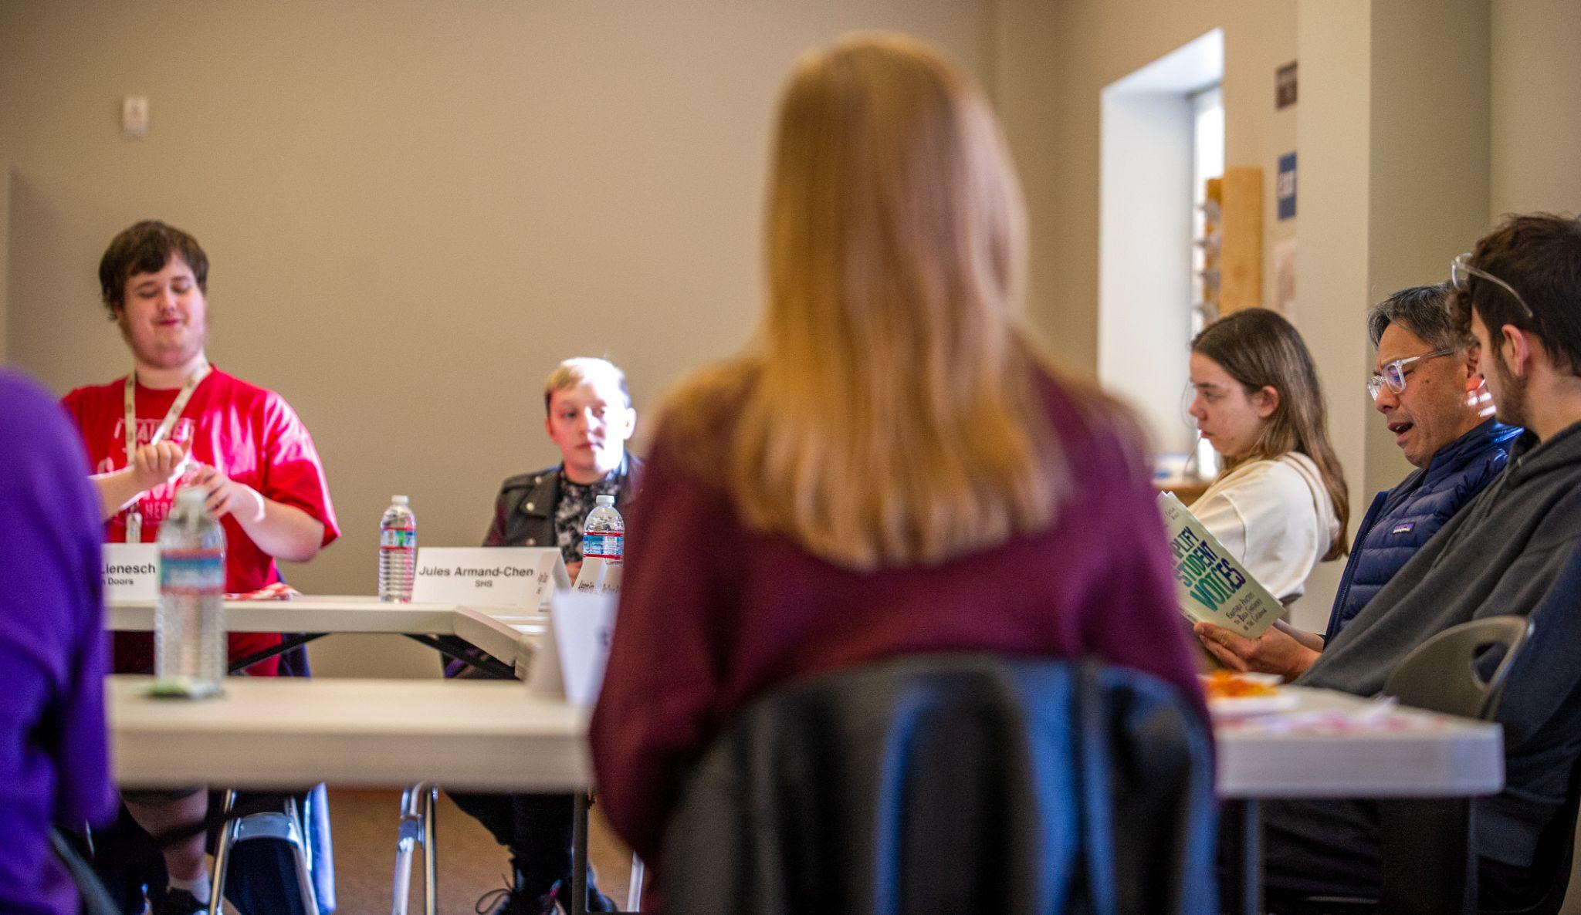
Most Important Topics
Student safety
Relationships between staff and students
Trust
Responsiveness
Follow through/follow up
Harassment, Intimidation and Bullying (HIB)
Equity and Inclusion

Slide 7
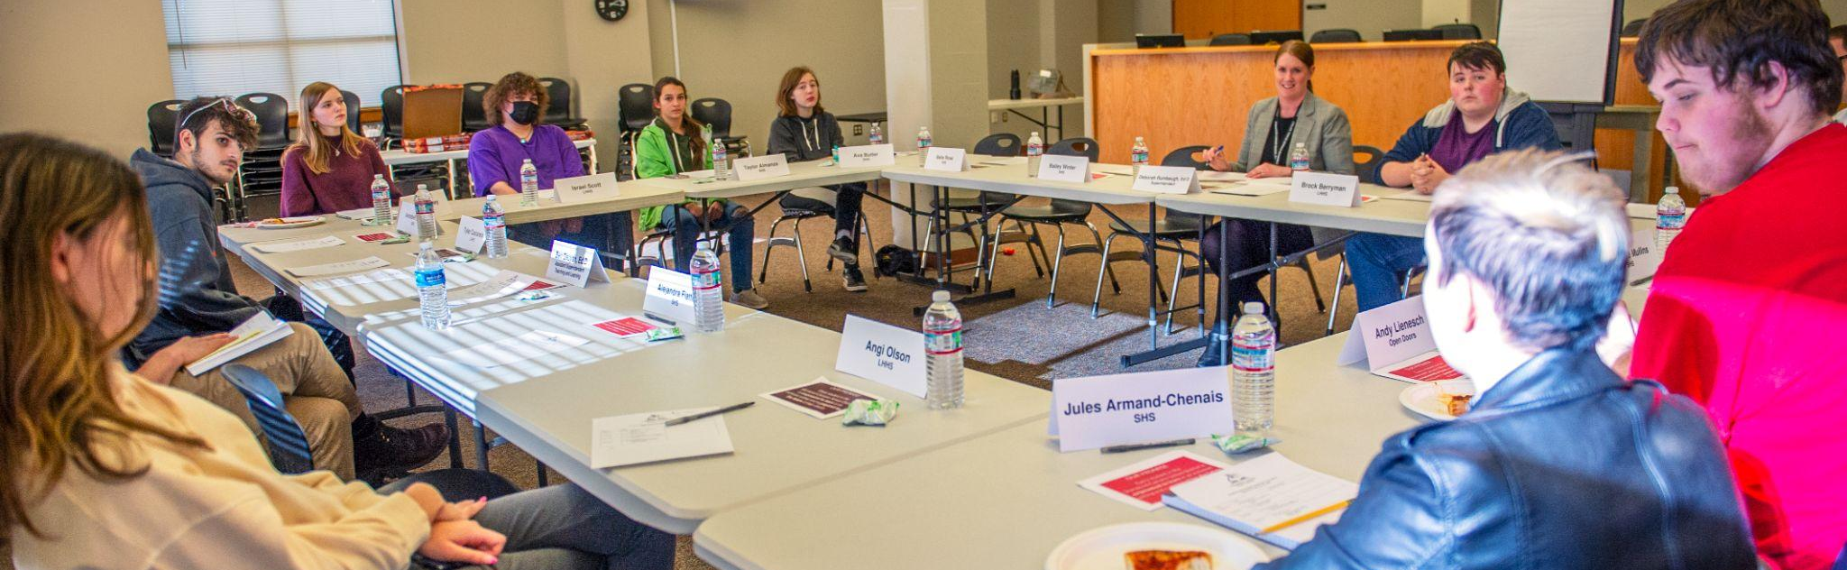
SSLT Accomplishments & Next Steps
Identification of key areas of work, and suggestions for improvement
Consistent meetings with strong representation by students
Guest speakers at 3 of the meetings
Finalizing process for 2023-2024 school year

Slide 8
Questions?

